Slide 1
From virtualisation… … to the cloud
(part 2)

Slide 2
Network virtualisation

Slide 3
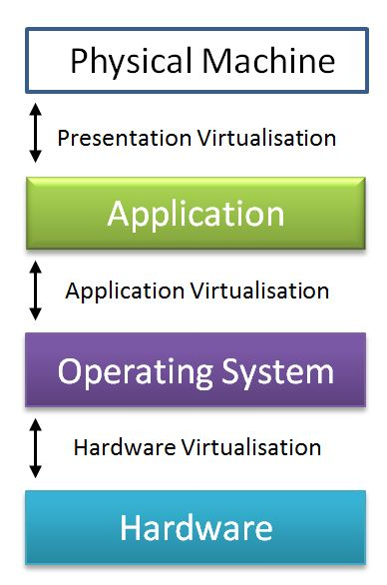
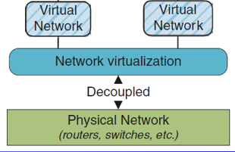

Network virtualisation

Slide 4
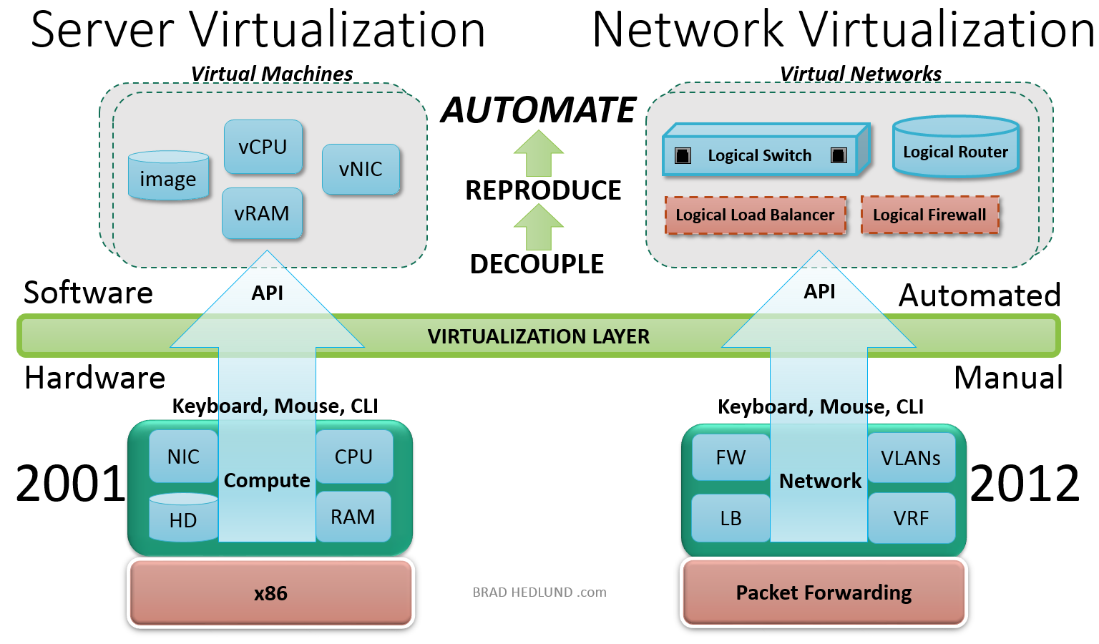
Server and network virtualization
Source: Brad Hedlund

Slide 5
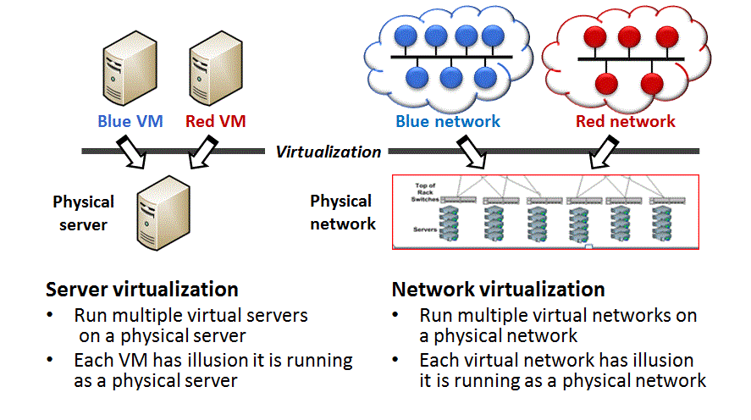
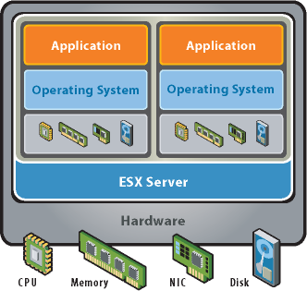
Network virtualisation
Create logical, virtual networks decoupled from the underlying network hardware to ensure the network can better integrate with and support increasingly virtual environments.

Slide 6
Network virtualisation
Combine hardware and software network resources and functionality into a single, software-based administrative entity, a virtual network
Create a logical software-based view of the hardware and software networking resources (switches, routers, load balancers, firewalls, etc.).

Slide 7
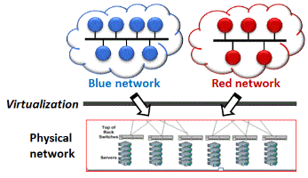
External virtualisation
Combine many networks or parts of networks into a virtual network
Subdivide one or more local area networks (LAN) into virtual networks (VLAN) to improve a large network’s or datacenter's efficiency
Split the available bandwidth into independent channels, assigned to different servers and devices, independently secured

Slide 8
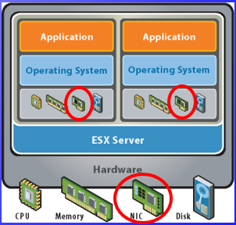
Internal virtualisation
Provides network-like functionality to software containers on a single network server
Configures a single system with software containers, or pseudo-interfaces, to emulate a physical network with software. This can improve a single system's efficiency by isolating applications to separate containers or pseudo-interfaces.

Slide 9
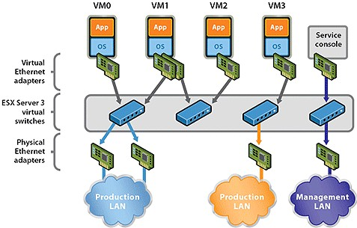
Internal network virtualization (VMware)
Source: VMware ESX

Slide 10
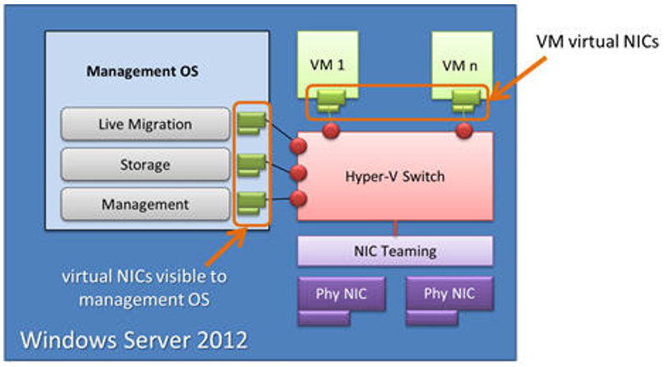

Internal network virtualization (Hyper-V)
Hyper-V Abstraction Layer and Virtual Switch

Slide 11
Players
External
Cisco
Juniper
Citrix Netscaler
…
Internal
VMware NSX
Microsoft Virtual Server & Hyper-V
…

Slide 12
Storage virtualisation

Slide 13
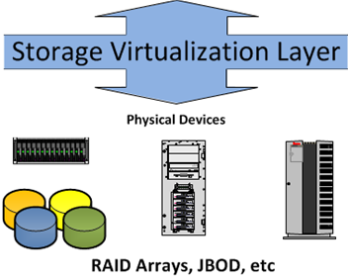
Storage virtualisation
Storage

Slide 14
Storage architectures
DAS: Direct Attached Storage
Disks (arrays) directly connected to a server
NAS: Network Attached Storage
Storage devices directly connected to the network
Directly accessible from all devices on this network
SAN: Storage Area Network
A network dedicated to the storage devices
Typical suppliers: Dell/EMC, HP, IBM, NetApp…
Notes:
Disk arrays – baies de stockage

Slide 15
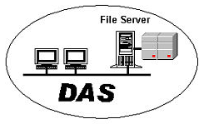
Storage architectures – DAS
Limited access and sharing
Distributed management, back-up…
Examples:
USB Hard disk on a PC
RAID arrays
SCSI or Fiber Channel based
Low cost storage bays
File Servers, Mail servers …
… limits for high performance, DB servers…

Slide 16
Storage architectures – NAS & SAN
Easier and more efficient capacity management
Simplified administration
Sharing
Data replication, business continuity

Slide 17
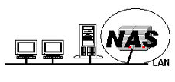
Storage architectures – NAS
Integrated file system, based on SMB/CIFS (Common Internet File System) for Windows and/or NFS (Network File System) for Unix/Linux.
Access at the level of the file, usually supporting concurrent access…
Support FTP, http
Typical in SME
File servers…

Slide 18
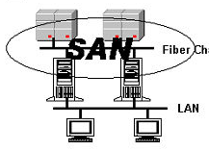
Storage architectures – SAN
More at the hardware level
Shows « LUNS » (*) to the servers, as a collection of blocks
considered by these as local disks, so file system managed by the server
No sharing / limited read sharing
(*) LUNs are a reference to specific storage in a SAN. A LUN can represent a hard disk drive (HDD), a portion of an HDD or even a full storage array.

Slide 19
Storage architectures – SAN
Dedicated high speed fiber optics network
Can host more than « disks »
→ tape libraries, archiving systems…
→ specialised servers (back-up, indexing, search…)
No interaction with the LANs (back-ups…)
More efficient, but more complex and expensive

Slide 20
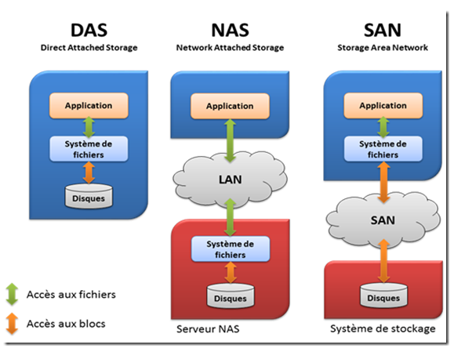


DAS / NAS / SAN basic architectures

Slide 21
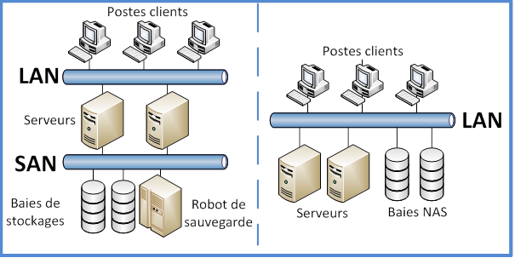
SAN vs. NAS

Slide 22
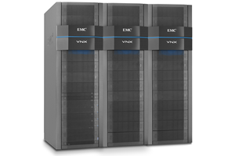
Great variety of solutions
Some TB → 500 TB – 4 PB
Flash memory based systems
Low cost disks for archiving
Hierarchical storage
…

Slide 23
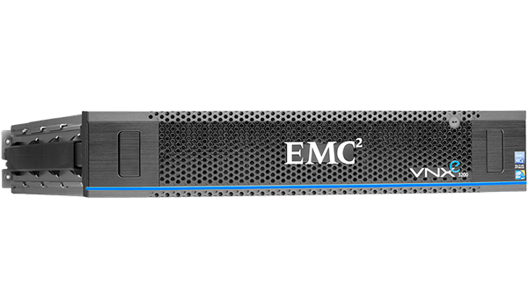
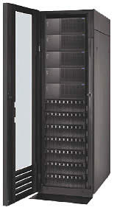
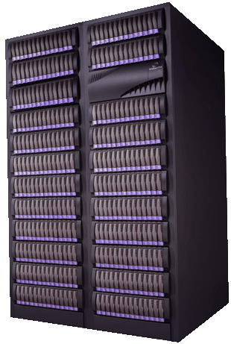

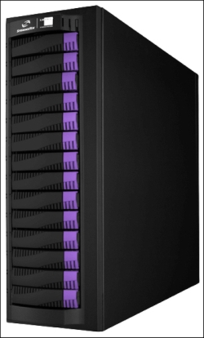
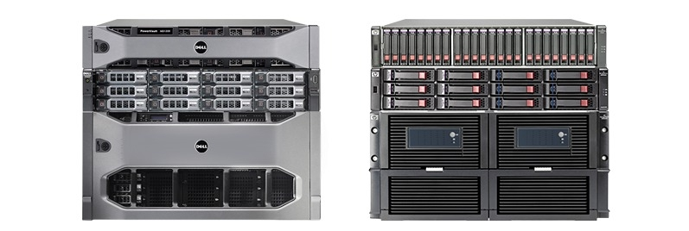

Slide 24
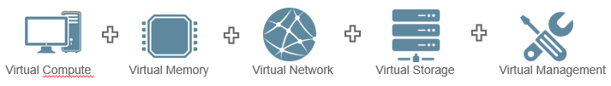
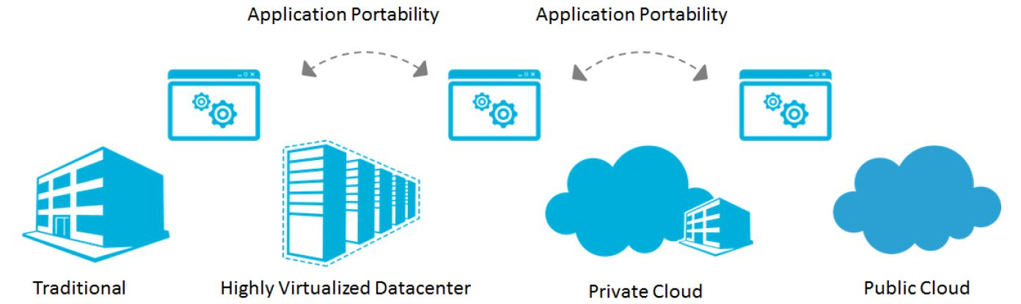
Converged infrastructure → Cloud

Slide 25
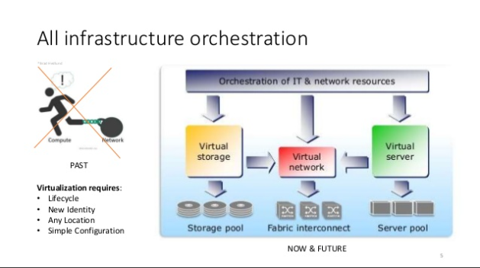
Converged infrastructure
Grouping multiple IT components into a single, optimized computing package.
servers,
data storage devices,
networking equipment
software for infra management, automation and orchestration …

Slide 26
Converged infrastructure → Way to the cloud
Enabling platform for private and public cloud computing services
Infrastructure as a Service (IaaS),
Platform as a Service (PaaS),
Software as a Service (SaaS).
Characteristics well suited to cloud deployments:
pool IT resources
automate resource provisioning
scale up and down capacity quickly

Slide 27
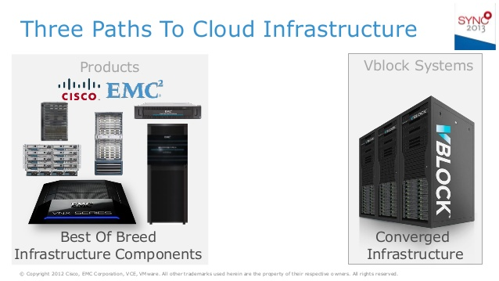
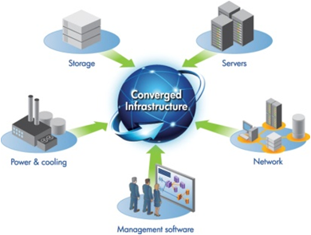
Converged infrastructure solutions
Converged systems
Dell / VCE(*) Vblock
IBM PureFlex
Hitachi
HP Helion CloudSystem
NetApp
Oracle
VCE = VMware / Cisco / EMC consortium

Slide 28
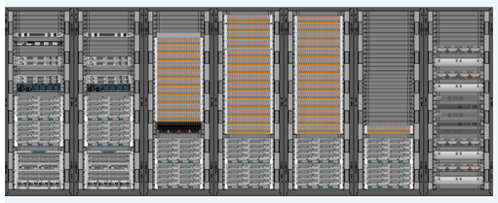



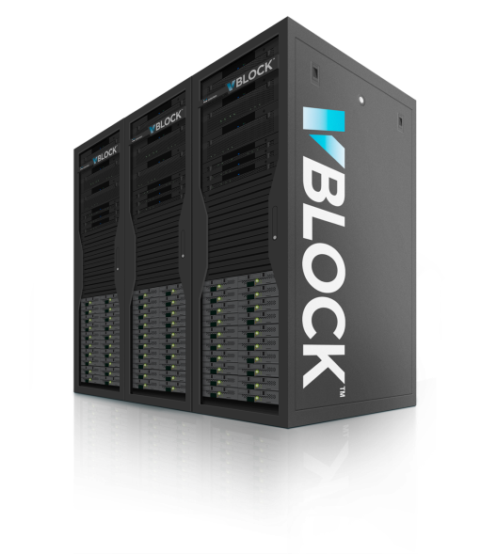







Example: Dell / VCE Vblock
Vblock
Orchestration
VCO
Inventaire et conformité
VCM
Virtual Infra et Monitoring
VCOPS
Infra : VISION
VM : UM
Gestion des versions / patching
Administration matérielle
UCSD
Administration matérielle
Administration hyperviseur
Vcenter
Hypervision
ESXi
LAN
Nexus
Serveur
FI / UCS
SAN
MDS
Virtu stockage
VPLEX / PRA
Stockage
VNX
Vblock 340 with 56 servers, 1000 disks for 660 TB efficient

Slide 29
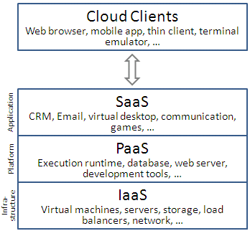
Cloud computing
Provide shared computer services, processing resources and data to computers and other devices on demand
Keywords
On-demand
Rapidly
Minimal management effort
IaaS, PaaS, SaaS
Amazon (2006), Microsoft Azure (2010), Google…

Slide 30
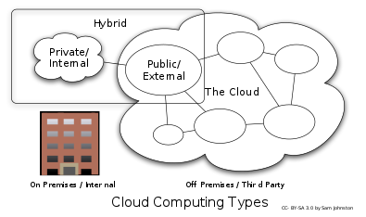
Cloud computing in big companies
Cloud computing principles can be implemented internally in an enterprise
→ Private cloud
Dedicated to a single organization
Total control on
Data localization
Data access – Security
…

Slide 31
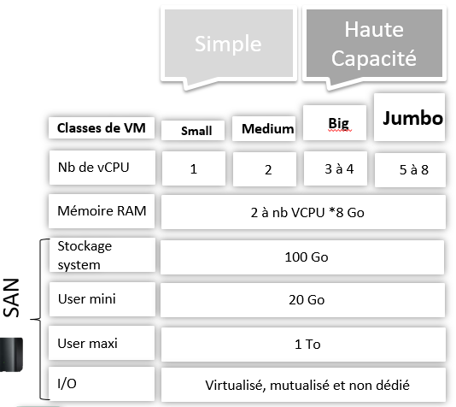
Faster delivery
From 5 months to…
… 5 weeks with virtualization
… 5 days with standardization and industrialization
… 5 hours of effective work
… later 50’
… or even 5’ ???

Slide 32

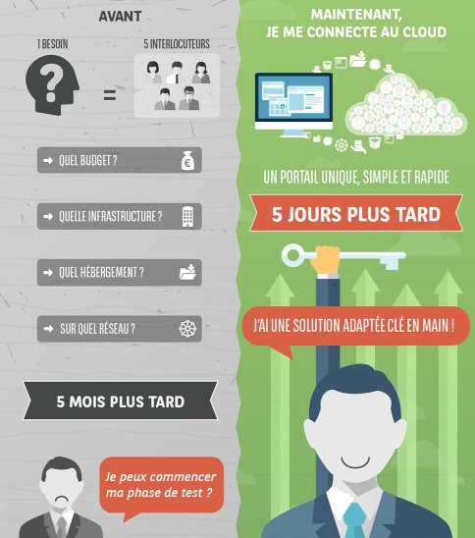
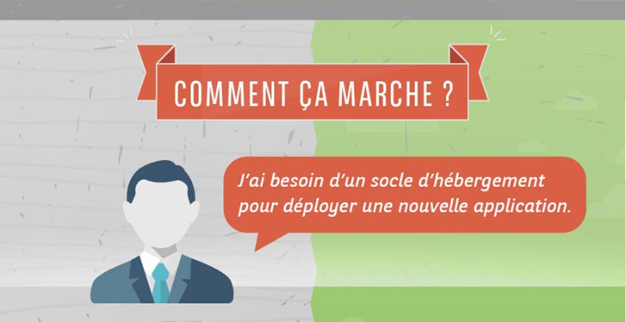
Présentation générale
Comment ça marche ?

Slide 33
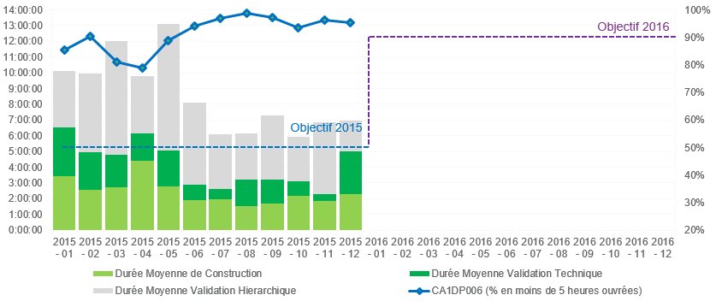
More efficient delivery
More than 90% of requests implemented in less than 5 hours of work
x

Slide 34
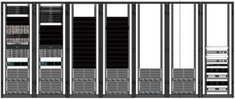
Datacenter management
Transparent failover between Vblocks
More than 11000 transfers of VMs between Vblock realized manually or automatically (initiated by the system)

Slide 35
Support datacenters evolution – moves
Migration using Vsphere Replication Appliance
Around 3000 VMs production and non production moved in intra site from ESX servers to Vblock without IP address change
Around 600 VM relocated between datacentres without IP address change (100% successfully)

Slide 36



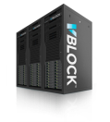
Migration ESX to Vblock within new Datacentres : 3 scenarios possible
Move directly to Vblock during the Data centre move
Move to Vblock during the Data centre move, using 2 steps migration method
Move ESX form DC 1&2 to temporary ESX in DC 3&4
Move temporary ESX to Vblock within the same data centre
Move to Vblock after the Data centre move project
DC 1
DC 2
DC 3
DC 4
VMotion
2
VMotion
VMware vSphere
VMware vSphere
VMware vSphere
VMware vSphere
ESX
ESX
ESX
3
ESX
Vsphere Replication
1
FC
Vsphere Replication
VMotion
Constraint: DRP compliancy before, during and after the move
Without transformation inside VM even backup / scheduling / SMI agent.

Slide 37
Top 10 benefits of server virtualization (InfoWorld)
Help moving things to the cloud
Extend the life of older applications
Isolate applications
Improve disaster recovery
Increase uptime
Reduce hardware vendor lock-in
Faster server provisioning
QA/lab environments
Reduce the data center footprint
Save energy, go green

Slide 38



